Slide 2
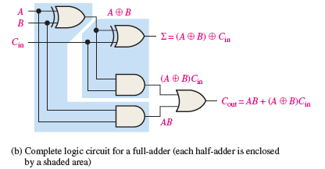
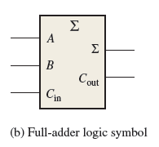

Slide 3
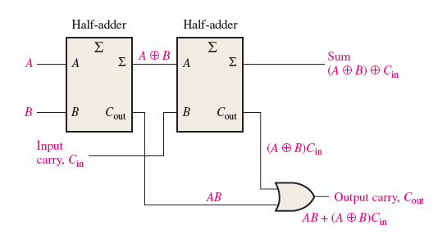
Full Adder from Half adder

Slide 4
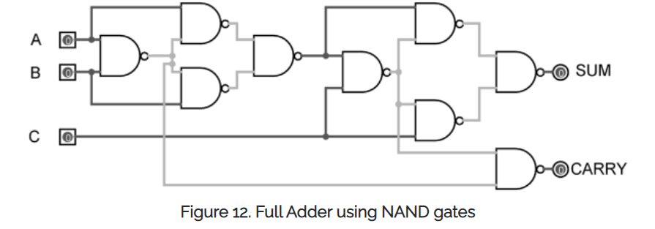

Slide 5

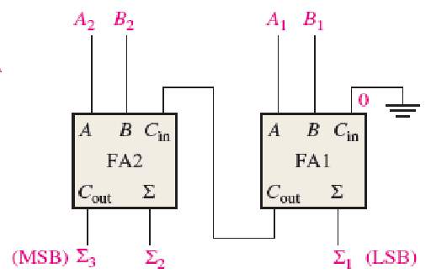

Slide 6

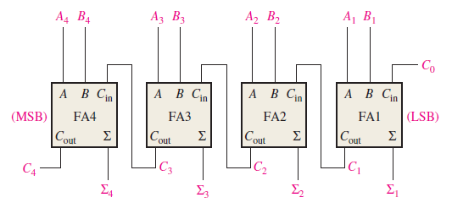

Slide 7
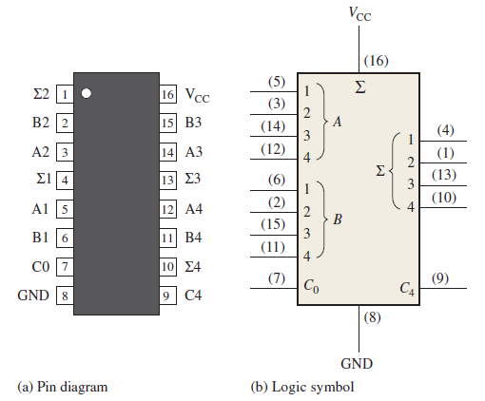

Slide 8
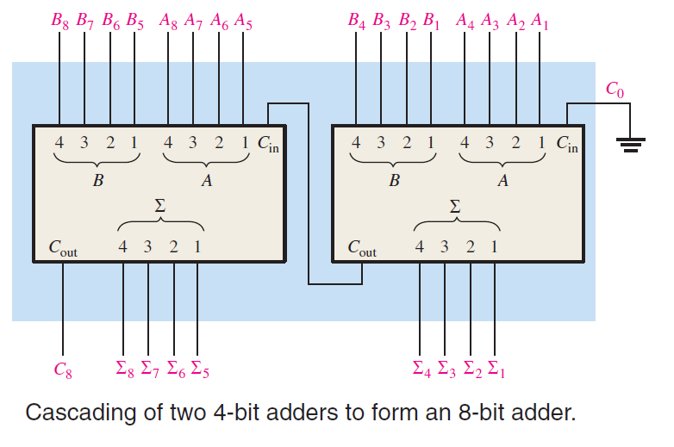

Slide 9
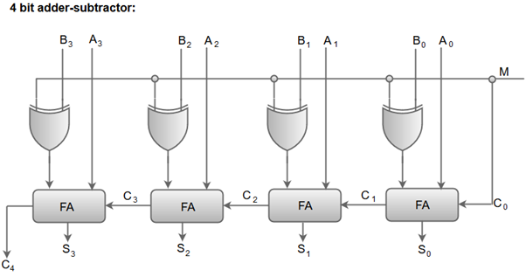
When M is at a high logic, we have B⊕ 1 = B' and C0 = 1. The B inputs are complemented, and a 1 is added through the input carry.
The circuit performs the operation A plus the 2's complement of B.

Slide 10
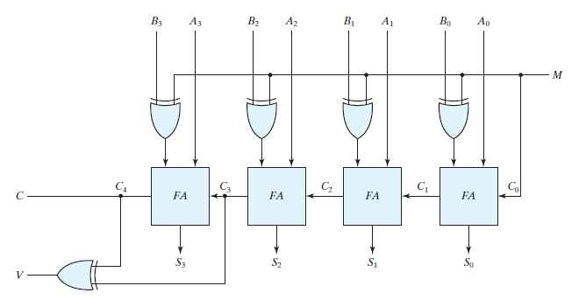

Slide 11


Overflow Condition
Since the answer cannot be accommodated within eight bits, we say that an overflow has occurred.
An overflow condition can be detected by observing the carry into the sign bit position and the carry out of the sign bit position.
If these two carries are not equal, an overflow has occurred

Slide 12
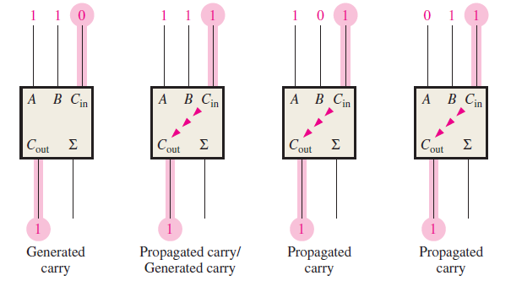


Slide 13
Problem With Parallel Adder

Slide 14
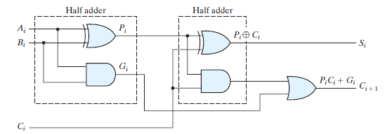





Slide 15
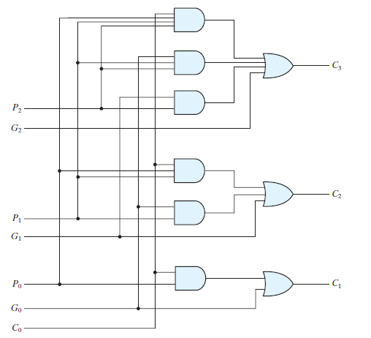

Slide 16
